Slide 1

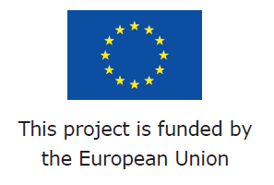
RAIN - Risk Analysis of Infrastructure Networks in Response to Extreme Weather
OCEANEXT
Nantes, France
9th June 2016
Dr. Alan O’Connor
Dept. of Civil Engineering, Trinity College Dublin
alan.oconnor@tcd.ie
www.rain-project.eu

Slide 2
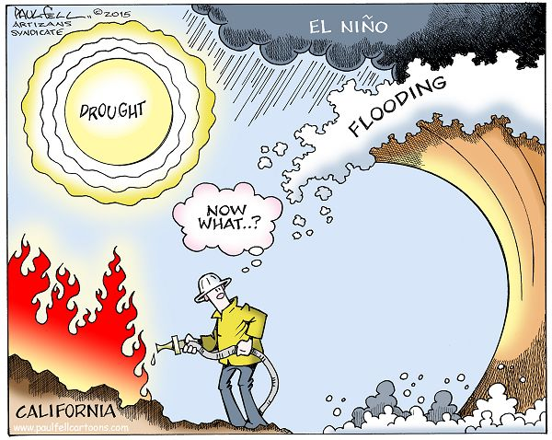

Slide 3
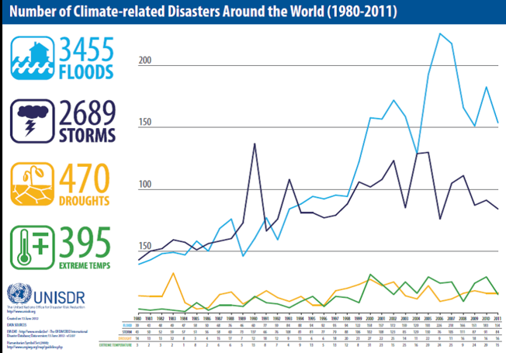

Slide 4
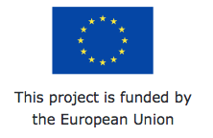
Introduction
Project RAIN – Risk Analysis of INfrastructure Networks in Response to Extreme Weather
FP7 Theme 10 - Security Activity - 10.2 Security of Infrastructures and Utilities SEC-2013.2.1-2 - Impact of Extreme Weather on Critical Infrastructure'.
  'Activities will concentrate on targets of an incident or disaster of transnational importance…, significant sites of political or symbolic value and utilities being those for energy (including oil, electricity, gas), water, transport (including air, sea, land), communication (including broadcasting), financial, administrative, public health, etc.
  A series of capabilities are required to cope with this mission area, many of which primarily relate to the phases "protect" but also "prepare”.

Slide 5
Introduction
  The ambition is both to avoid an incident and to mitigate its potential consequences.
  emphasis will be on issues such as: analysing, modelling and assessing vulnerabilities of physical infrastructure and its operations; securing existing and future public and private critical networked infrastructures, systems and services with respect to their physical, logical and functional side; control and alert systems to allow for quick response in case of an incident; protection against cascading effects of an incident, defining and designing criteria to build new secure infrastructures and utilities.'

Slide 6
RAIN Vision
  To develop a systematic risk management framework that explicitly considers the impacts of extreme weather events on critical infrastructure and develops a series of mitigation tools to enhance the security of the pan-European infrastructure network.
  To do this we must:
  quantify the complex interactions between weather events and land based infrastructure systems (i.e. transport, telecoms, energy etc.),
  develop an operational analysis framework that considers the impact of individual hazards and the coupled interdependencies of critical infrastructure through robust risk and uncertainty modelling,

Slide 7
interactions between weather events and land based transportation systems
(source: Makkonen, Törnqvist and Kuusela-Lahtinen, VTT)

Slide 8
RAIN Vision
  To develop a systematic risk management framework that explicitly considers the impacts of extreme weather events on critical infrastructure and develops a series of mitigation tools to enhance the security of the pan-European infrastructure network.
  To do this we must:
  quantify the complex interactions between weather events and land based infrastructure systems (i.e. transport, telecoms, energy etc.),
  develop an operational analysis framework that considers the impact of individual hazards and the coupled interdependencies of critical infrastructure through robust risk and uncertainty modelling,

Slide 9
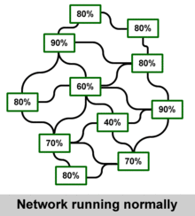
RAIN Vision
  considering cascading hazards, cascading effects and time dependent vulnerability
  Develop Technical and Logistic solutions to minimise the impact of these extreme events, include novel early warning systems, decision support tools and engineering solutions to ensure rapid reinstatement of the infrastructure network
Network Performance

Slide 10
RAIN Consortium

Slide 11
Background
  In recent years, the complex interdependencies of the European/International infrastructure networks have been highlighted through multiple failures during extreme weather events. These failures have been the driver for this project, e.g.
  Hurricane and Severe Storm damage (2012) - Hurricane Sandy - largest Atlantic storm on record devastated portions of the Caribbean, Mid-Atlantic and North Eastern United States
  193 people were killed along the path of the storm in seven countries
  damage >$20 billion(USD) losses (including business interruption) > $50 billion
  Jamaica: winds left 70% of residents without electricity, blew roofs off buildings, killed one, and caused about $55.23 million in damage.

Slide 12
Background
Haiti: Sandy's outer bands brought flooding that killed at least 54, caused food shortages, and left about 200,000 homeless,
Cuba: extensive coastal flooding and wind damage inland, destroying some 15,000 homes, killing 11, and causing $2 billion in damage,
United States: affected at least 24 states, from Florida to Maine and west to Michigan and Wisconsin, with particularly severe damage in New Jersey and New York.
  Its storm surge hit New York City on October 29, flooding streets, tunnels and subway lines and cutting power in and around the city.
  New York Stock Exchange remaining closed for trading for two days.
  7 subway tunnels under the East River were flooded, which the Metropolitan Transportation Authority stated early on October 30 “that the destruction caused by the storm was the worst disaster in the 108-year history of the New York City subway system”.
  Gas shortages throughout the region.

Slide 13
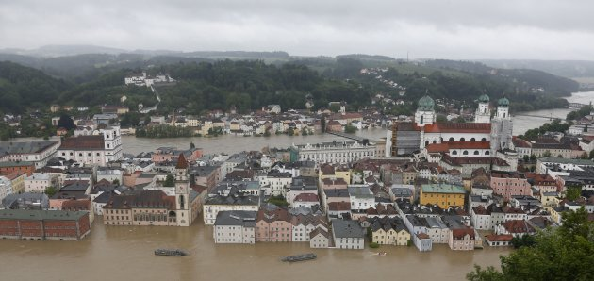
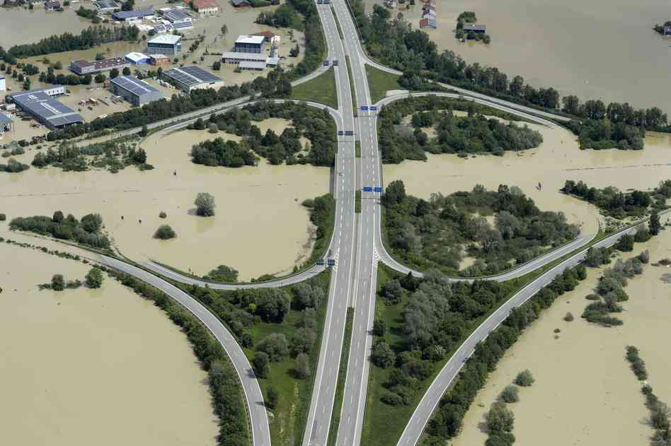
Flash Floods
Central Europe, 2002
deaths of approximately 150 people and an estimated €150 Billion worth of damage,
In Germany and the Czech Republic, the worst affected areas
  electricity failures, disconnected telecommunication links, damage to approximately 250 roads and 256 bridge structures,
  disruption to the Gas service due to damaged pipelines and contamination of clean water with flood water.
  restoration of important services to full capacity took approximately 1 month for electricity, 2 months for Gas and 3 months for telephone communications.

Slide 14
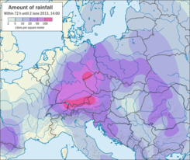
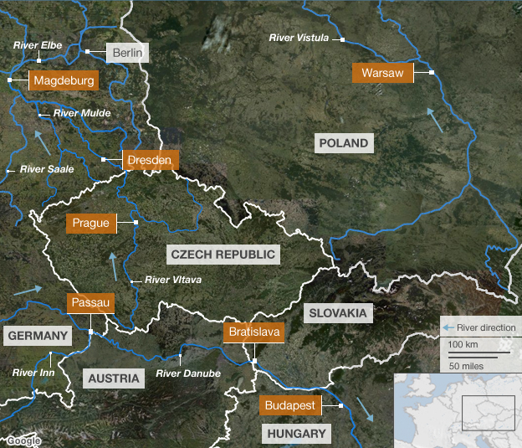
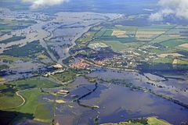
Flash Floods
Central Europe, 2013
deaths of 19 people and €bn’s worth of damage
Germany, Hungary and the Czech Republic, the worst affected areas
23,000 people leave homes in German city of Magdeburg where waters rose to 7.44m (normal 2m)!!

Slide 15
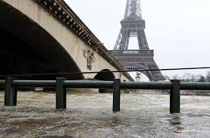
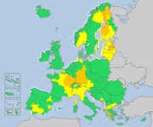
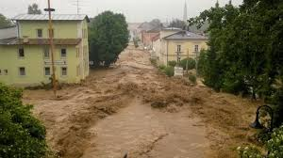
Flash Floods
Europe, 2016
deaths of 14 people (so far!) and €bn’s worth of damage!!

Slide 16
Objective
Risk Analysis of Infrastructure Networks must therefore:
quantify the complex interactions of the existing infrastructure systems and their interrelated damage potential in the event of specific extreme weather events,
(source: EWENTS FP7 Project)

Slide 17
Objective
Risk Analysis of Infrastructure Networks must therefore:
improve the robustness of Infrastructure Networks so that they will not experience disproportionate damage or disruption in the case of extreme events, i.e.:
  increase the level of redundancy in the infrastructure networks at critical nodes,
  improve the performance of key infrastructure and
  developing detailed plans for a range of potential emergency scenarios.

Slide 18
Objective
Risk Analysis of Infrastructure Networks must therefore:
develop systems that will accelerate re-establishing infrastructure links post an extreme event. This objective will require developing engineering solutions to assess the safety of land based structures, networks and substructures which facilitate rapid replacement of key infrastructure and emergency systems where necessary. Additionally we must seek to optimise the use of the in-tact network post any significant event.

Slide 19
Concept
Risk Analysis of Infrastructure Networks must therefore accept that extreme events (e.g. “100 year events”) are happening with alarming frequency. Thus preparing for these events is of vital importance.
We must attempt to quantify and thereby reduce uncertainty and gain a better understanding of how our critical infrastructures will cope and adapt to weather events to help ensure the security of vital utilities.
Requires interaction between several entities i.e. emergency planners, utility operators, first responders, engineers and most importantly the citizens living in the area of the extreme event.

Slide 20
Concept

Slide 21
Concept
Risk Analysis of Infrastructure Networks must:
consider the citizen as central. The citizen is the most important consideration in an extreme event. We must put the societal impacts of infrastructure failures in extreme weather events at the heart of any approach and develop risk mitigation strategies to minimise the risks of loss of life and disruption to quality of life.
minimise the risk of chaos in extreme weather events by predicting, using the most advanced statistical methods, how weather patterns are likely to emerge and then how our infrastructures will react under these events.

Slide 22
RAIN
Work Package Structure
WP Leaders
WP1 – TCD
WP2 – ESSL
WP3 – UNIZA
WP4 – AIA
WP5 – TU_Delft
WP6 – ROD
WP7 – GDG
WP8 – Youris

Slide 23

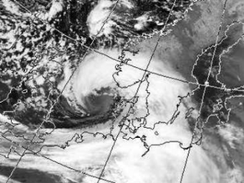
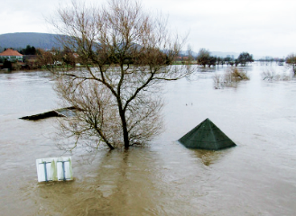
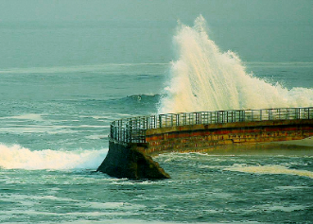
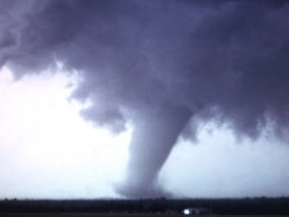
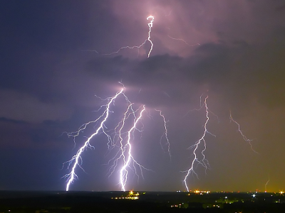
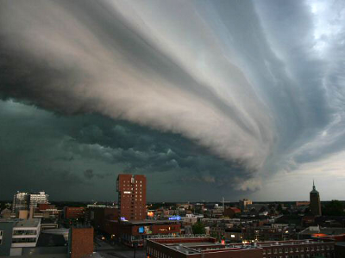
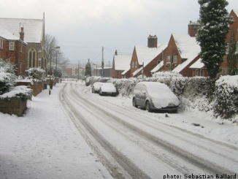
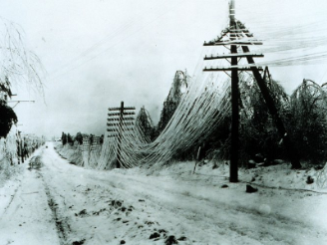
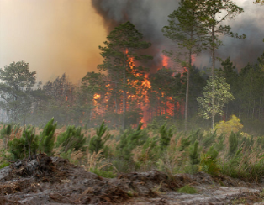
Hazard Identification
images (cc-by-sa license): thunderstorm gusts: John Kerstholt
snow storms: Sebastian Ballard, lightning: Timo Newton-Syms
heavy rain
wind storms
river floods
coastal floods
tornadoes
lightning, hail,
thunderstorm winds
snow storms
freezing rain
wildfires

Slide 24
Hazard Identification - Objectives
Hazard Identification
To identify the extreme weather events to be analysed in detail in RAIN, including defining appropriate intensity thresholds, taking into account regional differences in vulnerability and climate.
To assess the present state-of-the-art forecast systems for extreme weather and their characteristics, and to address and estimate their predictive skill.
To assess the frequency of weather hazards throughout Europe for both the present and future climate; by applying state-of-the-art methods to regional (CORDEX) and global (CMIP5) climate model data until the year 2100.

Slide 25
Hazard Identification - River & Coastal Flooding
Pan-European scale:
  extreme weather in
    Present & projected climate scenarios
    Coastal & river floods
European flood risk map of damages to flood defence systems.
To do that we need to consider:
River and coastal flood scenarios,
  river discharges and storm surges’ heights with given return periods…
Historical & Future Scenarios. Different scenarios of climate change…
Calculate the extent of floods, water levels and depth…
Assess the impact of those floods on the flood defence systems…

Slide 26
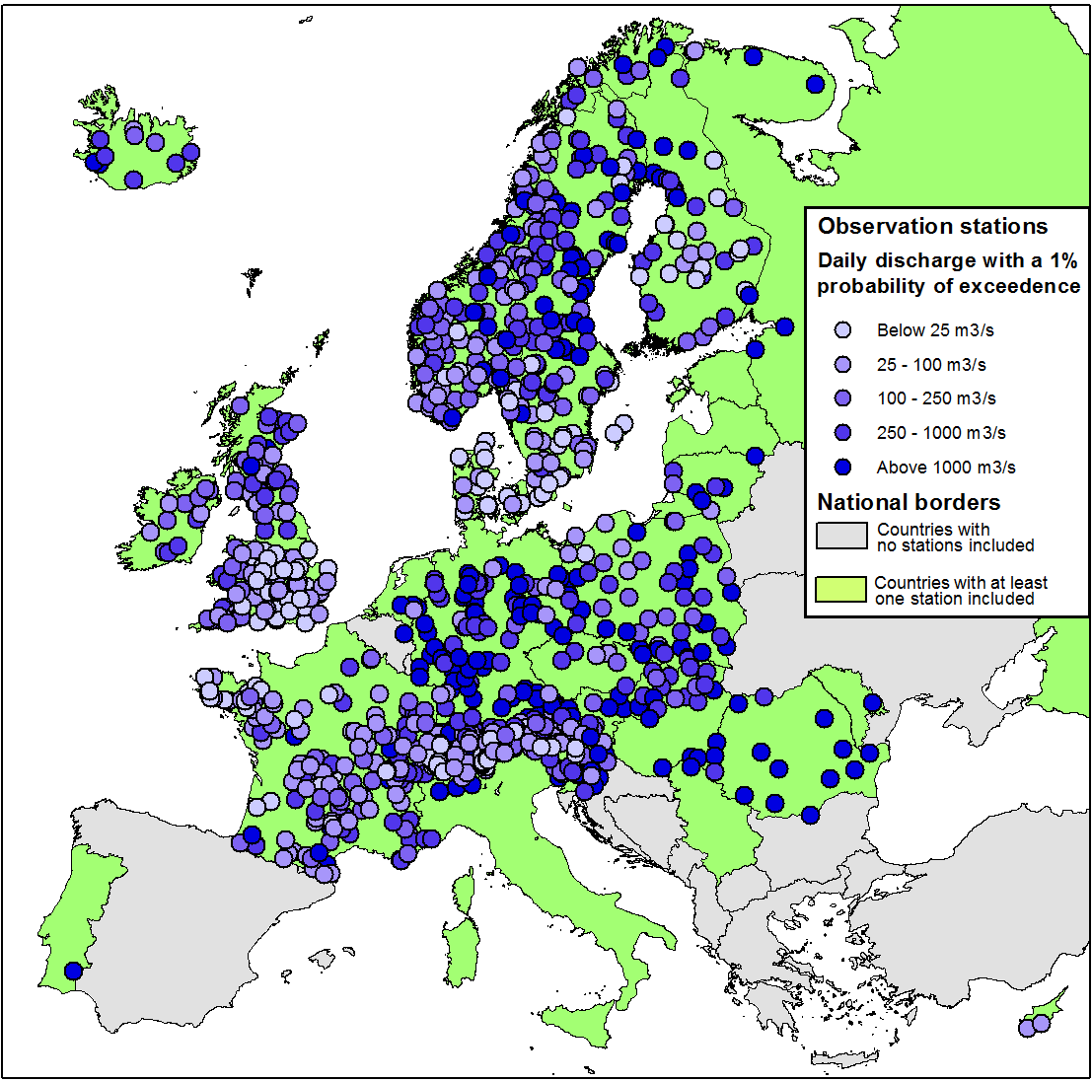
Hazard Identification- River & Coastal Flooding
River discharges
Stations with at least three full decades of continuous records (1951-2000)
Country | Stations
France | 163
Sweden | 142
United Kingdom | 136
Germany | 125
Norway | 101
Switzerland | 75
Other | 277
Total | 1019

Slide 27

Hazard Identification- River Discharge
Empirical discharge model for Europe
(to be used in RAIN)
Daily river discharges with a given return period (from observations)
Gauged
catchments
Meteorology: precipitation
snowmelt
Climate: annual characteristics
Soils
Land use
Topography: elevation, slopes
River network
Bayesian Network (BN): a statistical model correlating catchment parameters with river discharges
All European catchments
Daily river discharges with a given return period for all European rivers
RAIN Project – OCEANEXT Conference – 9th June 2016

Slide 28
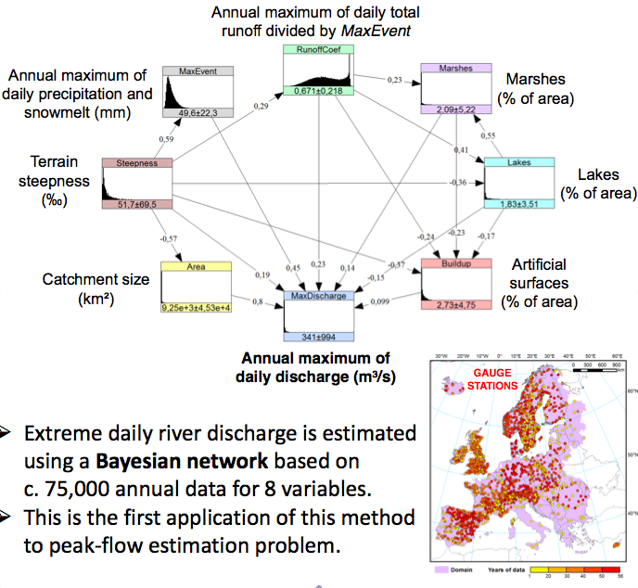
Hazard Identification- River & Coastal Flooding
Bayesian Network
Methodology

Slide 29
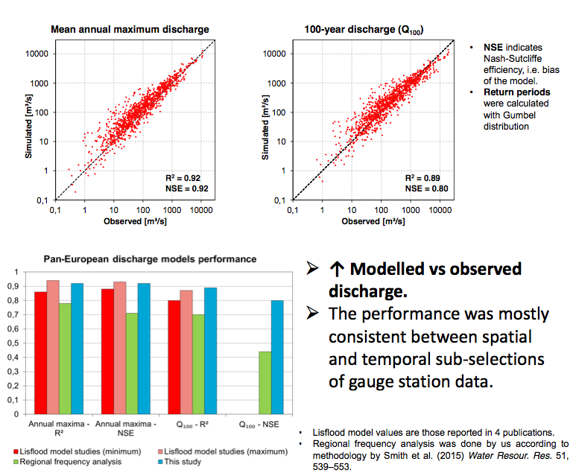
Hazard Identification- River & Coastal Flooding
Bayesian Network
Validation

Slide 30
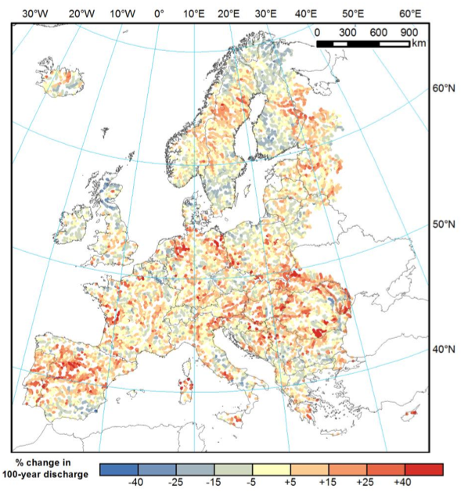
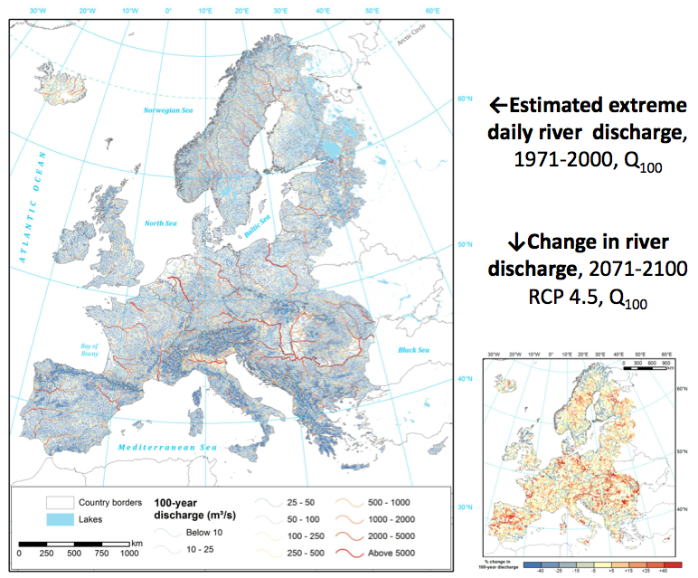
Hazard Identification- River & Coastal Flooding
Bayesian Network
Results

Slide 31
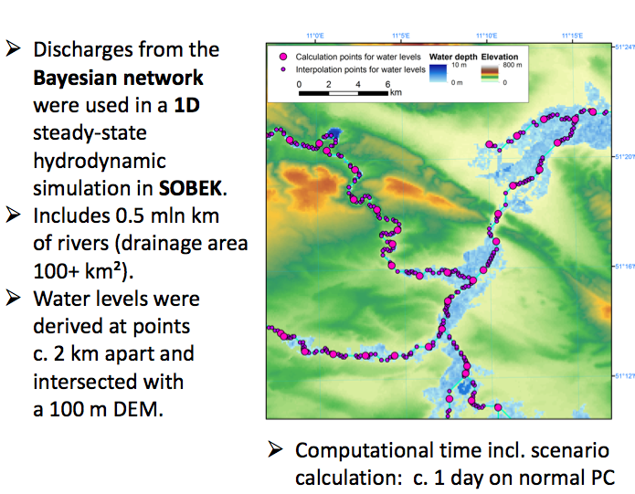
Hazard Identification- River & Coastal Flooding
Bayesian Network
Flood Extent

Slide 32
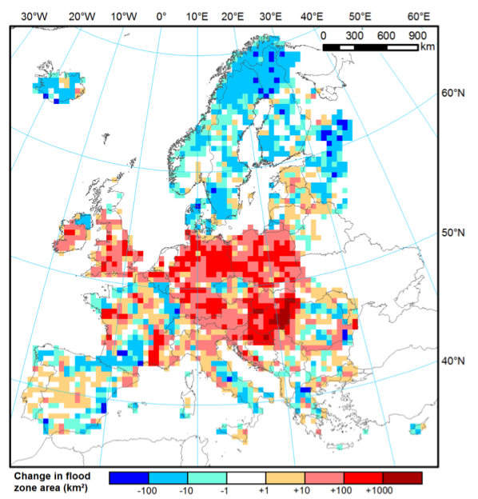
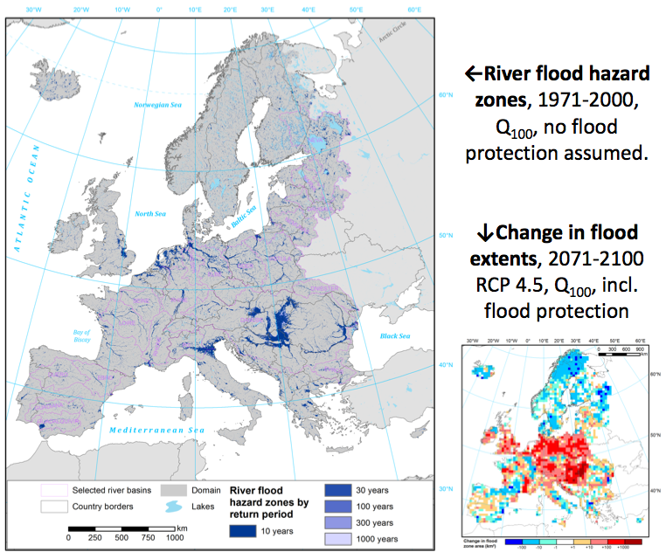
Hazard Identification- River & Coastal Flooding
Bayesian Network
Flood Extent

Slide 33
Hazard Identification- River & Coastal Flooding
Storm Surges
Tide model, bathymetry
Typical large-scale modelling procedure
Climate model
3-/6-hour wind speed and sea-level air pressure
Hydrodynamic model of the sea/ocean
Calculation of return period by fitting data to a probability distribution
3-/6-hour water levels
Shallow water equations
Validation with return periods from tide gauge records
Calibration with tide gauge records
Trouble: it requires considerable time to prepare and run

Slide 34
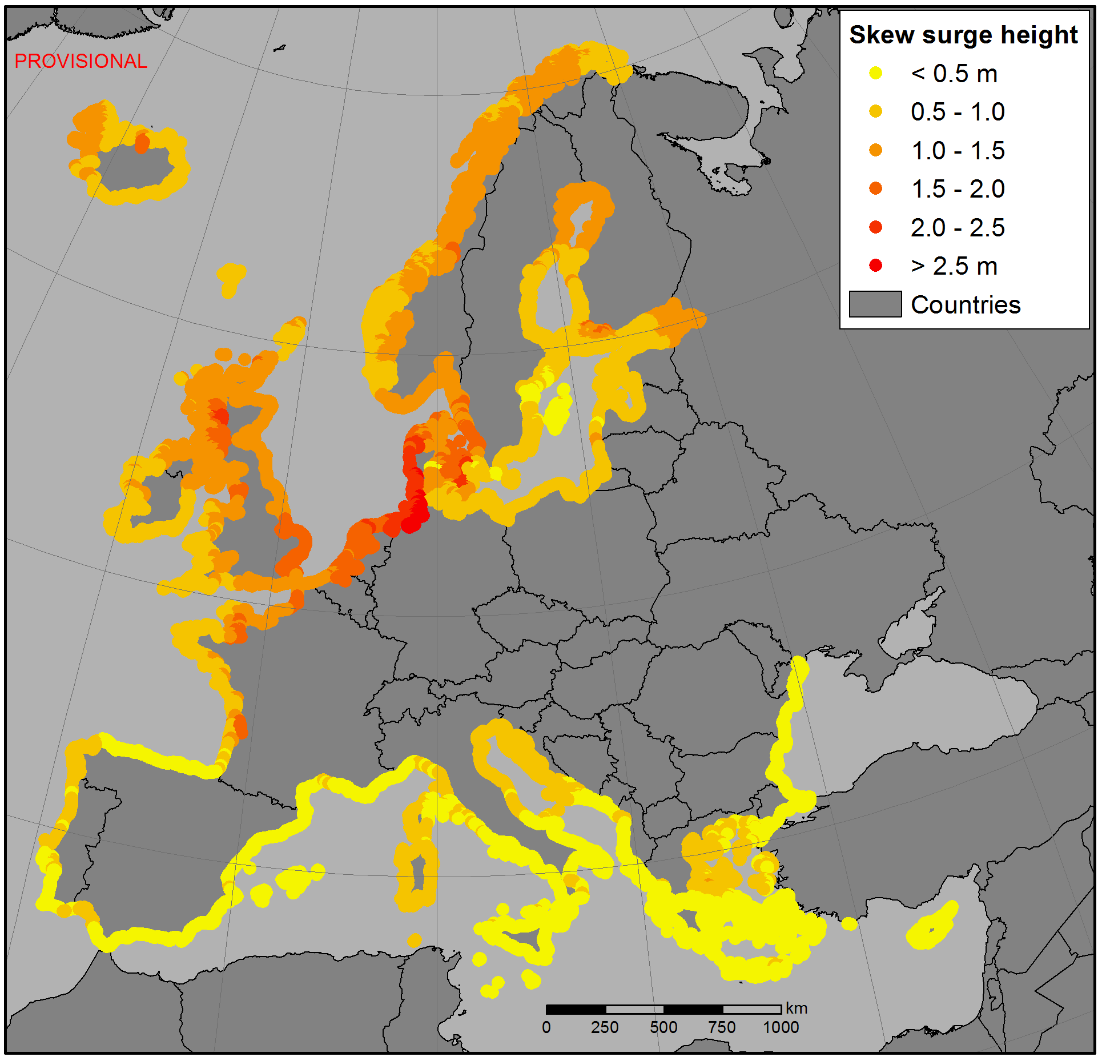
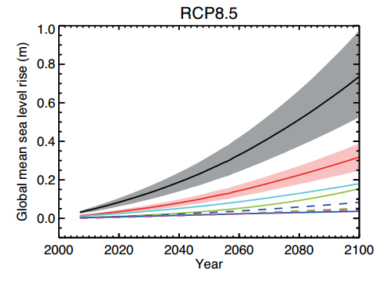
Hazard Identification- River & Coastal Flooding
Storm Surges
Preliminary Results:
Occurence of storm surges
(100-year return period) in Europe in present climate (TU Delft)
Sea level rise up to 2100
IPCC projections by emission scenario.

Slide 35
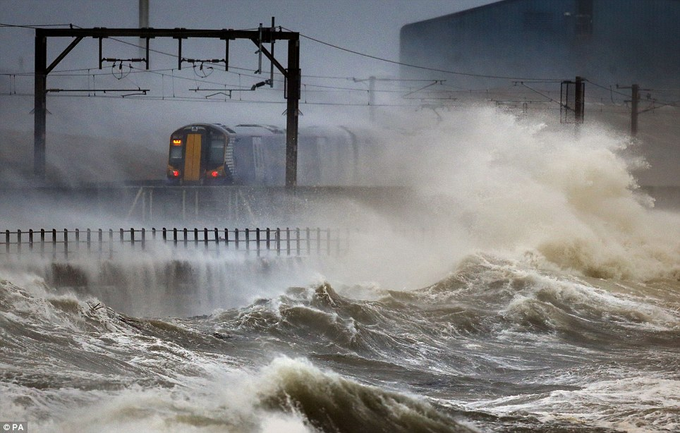
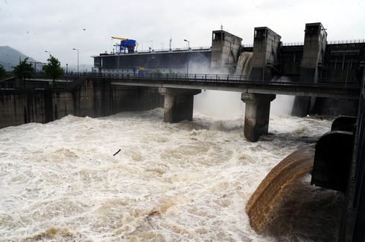
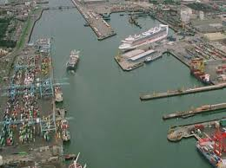
Infrastructure & Societal Vulnerability
Objective
To identify critical infrastructures, review their failures caused by extreme weather events and current means for their protection with the aim to develop an understanding on how failure of these infrastructures leads to societal vulnerability.

Slide 36
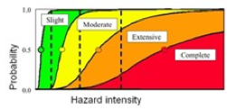
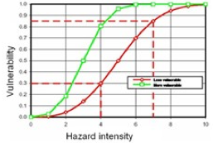
Infrastructure & Societal Vulnerability
Vulnerability is:
Multi-Dimensional (e.g. physical, social, economic, environmental, institutional etc.)
Dynamic (i.e. it changes with time)
Scale-Dependent (i.e. can be expressed at different scales, from human to household to community to country)
Site-Specific

Slide 37
Infrastructure & Societal Vulnerability
Vulnerability as a function of three elements (core factors):
Exposure to extreme weather events (presence of people, livelihoods; environmental services and resources; infrastructure; or economic, social, or cultural assets in places that could be adversely affected),
Susceptibility: the predisposition and likelihood to suffer harm when a hazard strikes a community or a system is exposed,
Adaptive Capacity: strengths, attributes, and resources available to an individual, community, society, or organization that can be used to prepare for and undertake actions to reduce adverse impacts, moderate harm, or exploit beneficial opportunities.

Slide 38
Infrastructure & Societal Vulnerability
The RAIN project has developed a multilevel approach for measuring societal vulnerability which leads to the determination of the overall Societal Vulnerability in the form of Vulnerability Index – VI,
The Vulnerability Index is formed by the three Vulnerability Core Factors (Exposure - E, Susceptibility - S, and Adaptive Capacity - AC, while Exposure and Susceptibility together create Potential Impact - PI),
Each of these three factors is formed by three different Societal Categories,
Societal Categories are formed by several Vulnerability Indicators, identified and described by 31 indicators of societal vulnerability,
The Vulnerability Index (VI) - the measure of societal vulnerability calculated on the basis of selected vulnerability indicators. The higher VI value the higher societal vulnerability.

Slide 39
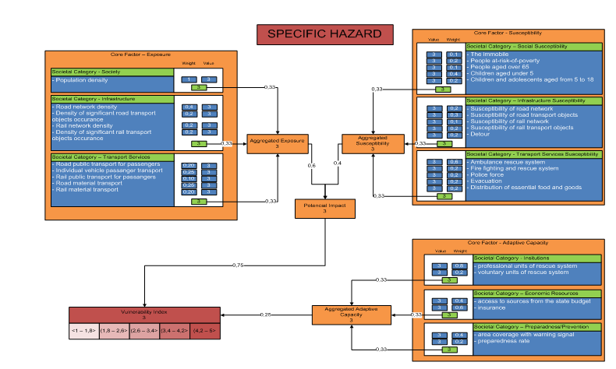
Infrastructure & Societal Vulnerability

Slide 40
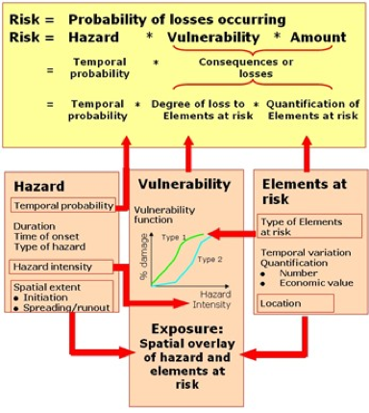
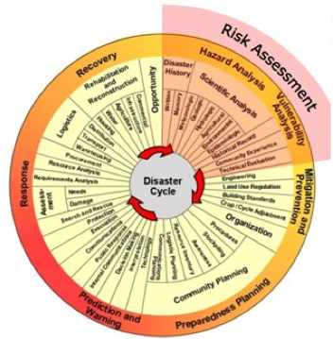
Risk Based Decision Framework
Source: United Nations University

Slide 41
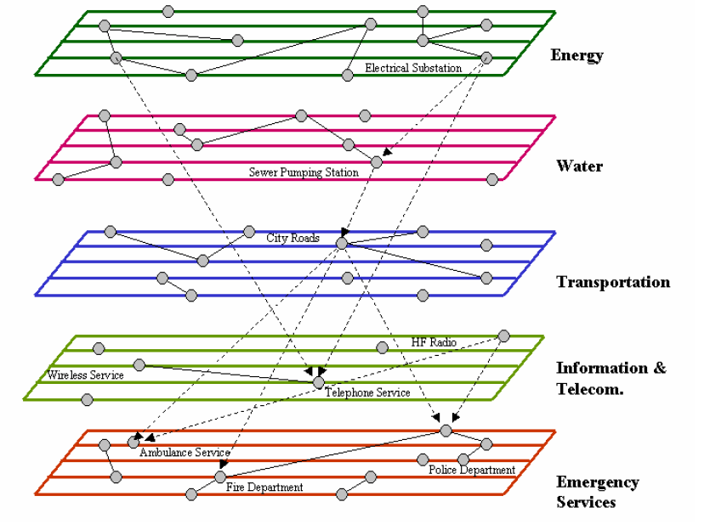
Risk Based Decision Framework - Objectives
To address the modelling approaches for critical infrastructures which are highly interconnected and form ‘systems of systems’ that tend to be vulnerable during extreme weather events.
To contribute to the development of a framework and methods for the quantitative analysis of risks for interconnected infrastructures.
To assess the societal, security and economic impacts of critical infrastructure failures, based on single and multi-mode failures. Based on the impacts of the failures, quantifiable benefits (from a societal, security and economic standpoint) of providing resilient infrastructure need to be identified.

Slide 42
Risk Based Decision Framework - Generation

Slide 43
Risk Based Decision Framework - Evaluation
Generation of Inference Networks (Bayesian Networks):

Slide 44
Risk Based Decision Framework - Evaluation
Combining Infrastructure Network
& Inference Networks:

Slide 45
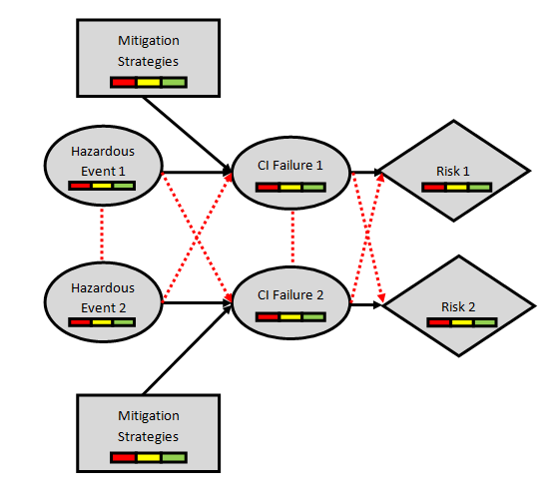
Risk Based Decision Framework - Evaluation
Considering Single Mode, Multi Mode Risks (Cascading Effects) & Assessment/Optimisation of Mitigation Measures (i.e. Risk Based Decision Making):

Slide 46
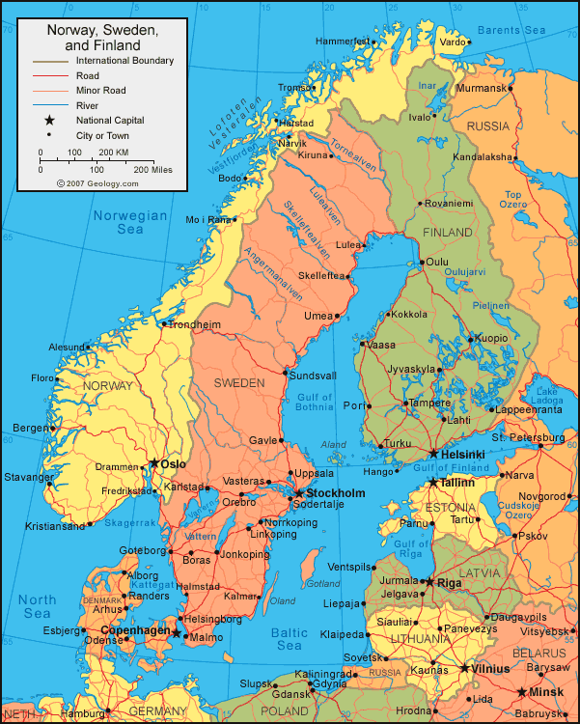
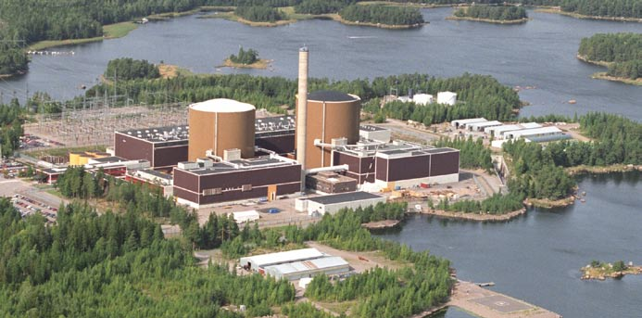
Risk Based Decision Framework - Evaluation
Risk procedure is being benchmarked against case studies conducted on the critical transport and operational tactical connections of the Loviisa nuclear reactor as a result of sudden flooding and rising seawaters at the Gulf of Finland. The focus of the benchmarking will be on early warning, response and consequence management of the Finnish National Security authorities and the management of the Loviisa Nuclear plant.

Slide 47
RAIN Vision
Risk Analysis of Infrastructure Networks must therefore:
  quantify the complex interactions between weather events and land based infrastructure systems (e.g. transport, telecoms, energy etc.),
  develop an operational analysis framework (i.e. Risk Based Decision Making Framework) that considers the impact of individual hazards and the coupled interdependencies of critical infrastructure through robust risk and uncertainty modelling,
  considering cascading hazards, cascading effects and time dependent vulnerability,
  develop Technical and Logistic solutions to minimise the impact of these extreme events, include novel early warning systems, decision support tools and engineering solutions to ensure rapid reinstatement of the infrastructure network.

Slide 48

RAIN Project www.rain-project.eu
Dr. Alan O’Connor alan.oconnor@tcd.ie

Slide 49
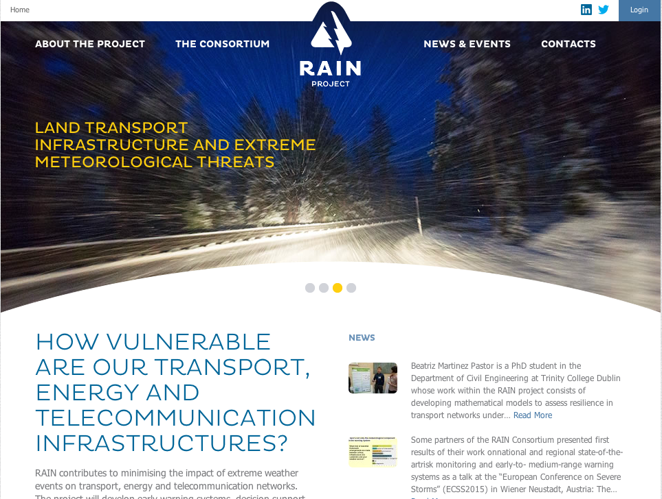
RAIN Project – OCEANEXT Conference – 9th June 2016

Slide 50
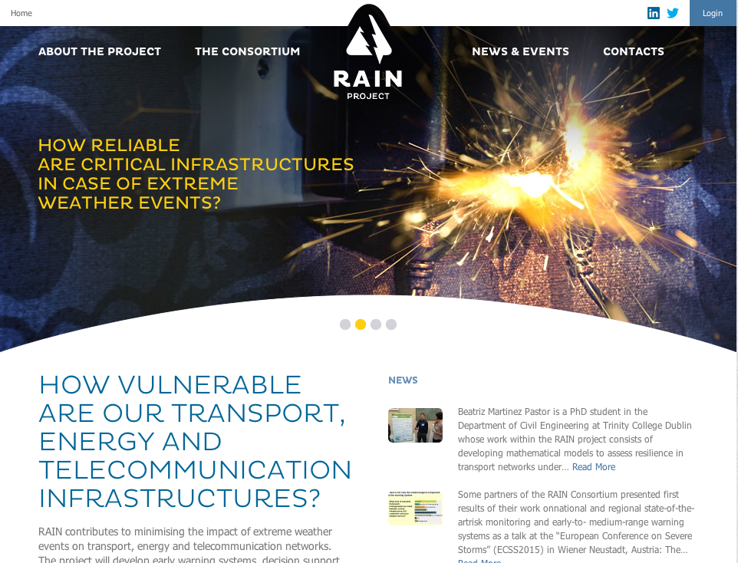
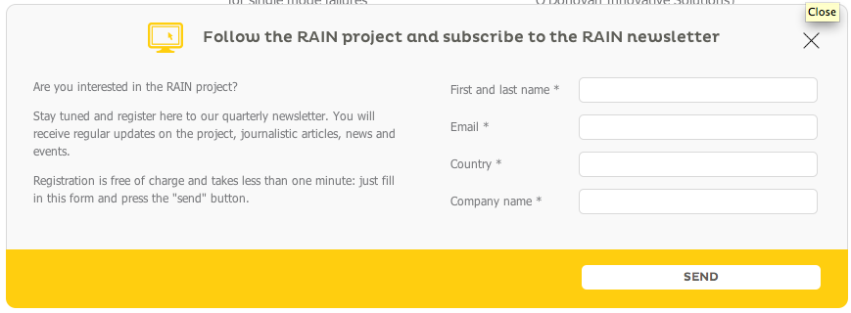

Slide 51


Slide 52
